Slide 1
Magenic Masters React Unit Testing
Feb 21, 2017
Tim Chan

Slide 2
Agenda
Jest
Enzyme

Slide 3
Jest
Testing platform created and used by Facebook to test all JavaScript code including React application.
Key Features
Easy setup and zero configuration
Fast and sandboxed
Built-in code coverage
Snapshot Testing

Slide 4
Jest - Setup
npm install --save-dev jest babel-jest babel-preset-es2015 babel-preset-react react-test-renderer
Create *.test.* or *.spec.* files

Slide 5
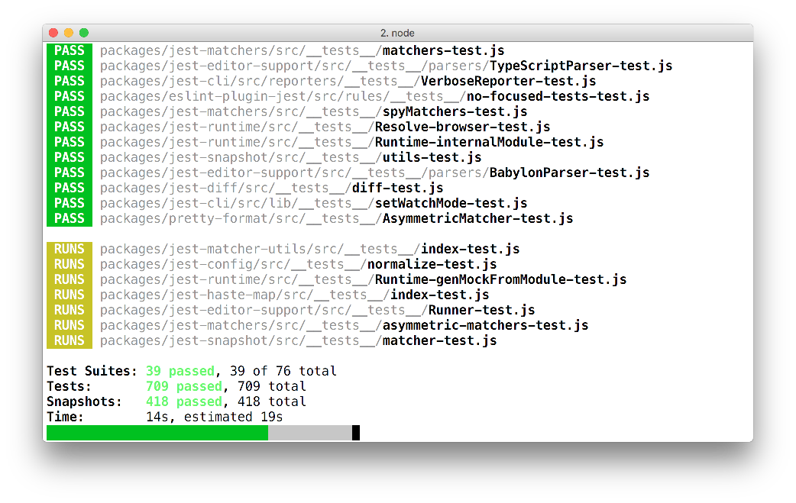
Jest – Fast and sandboxed
Parallelizes test runs across workers to maximize performance. Console messages are buffered and printed together with test results. Sandboxed test files and automatic global state resets for every test so no two tests conflict with each other.

Slide 6
Jest – Code coverage
jest --coverage

Slide 7
Jest – Snapshot testing
Useful to make sure your UI does not change unexpectedly.
A test renderer quickly generate a serializable value of your React tree and save it as a snapshot file
Tests are just comparing the new generated snapshot vs the snapshot file.
Additional reading: https://benmccormick.org/2016/09/19/testing-with-jest-snapshots-first-impressions/
Npm test -- -u / jest -u to update snapshot

Slide 8
Jest – DOM Testing
Testing by asserting, and manipulating rendered components.
Popular testing libraries
Enzyme by Airbnb.io
React TestUtils by Facebook

Slide 9
Enzyme
JavaScript testing utility for React
Easier API to assert, manipulate, and traverse your React components

Slide 10
Enzyme - Setup
npm install --save-dev enzyme react-addons-test-utils (react-addons-test-utils is a dependency)

Slide 11
Enzyme - shallow
Constrain yourself to testing a component as a unit.
Ensure that your tests aren’t asserting on behavior of child components.

Slide 12
Enzyme - render
Render react components to static HTML and analyze the resulting HTML structure

Slide 13
Enzyme - mount
Full DOM rendering for cases where you have components that may interact with DOM APIs or fully test the component lifecycle

Slide 14
Credits
Facebook Jest Page http://facebook.github.io/jest/docs
Airbnb Enzyme Page http://airbnb.io/enzyme/index.html
Sinon Page http://sinonjs.org/docs/

Slide 15

Questions?

Slide 16
Next session…
Deadline: Assignment #5 EOD Thursday
Assignment #6
Final Project Specifications

